Slide 1

Using Generative Adversarial Networks to Improve Phishing Domain Classifiers
Jen Burns
Emily Heath, PhD
The MITRE Corporation

Slide 2
Categorizing Phishing Domains
Phishing domains widely used by APT groups and criminal actors
  Goal: Obtain usernames, passwords, credit card information, etc.
Disguised in content that looks identical or nearly-identical to legitimate service or web site
  Domain name itself can be helpful in distinguishing
Scope of our work: Detect phishing domains from legitimate domains using only the domain name
Example Phishing Domains
  - amazon[.]co[.]uk[.]security-check[.]ga, update-apple[.]com[.]nbetawihosting[.]net
Classifier
Benign
www.google.com
Malicious

Slide 3
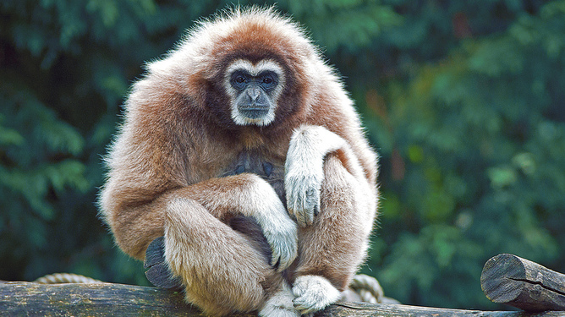
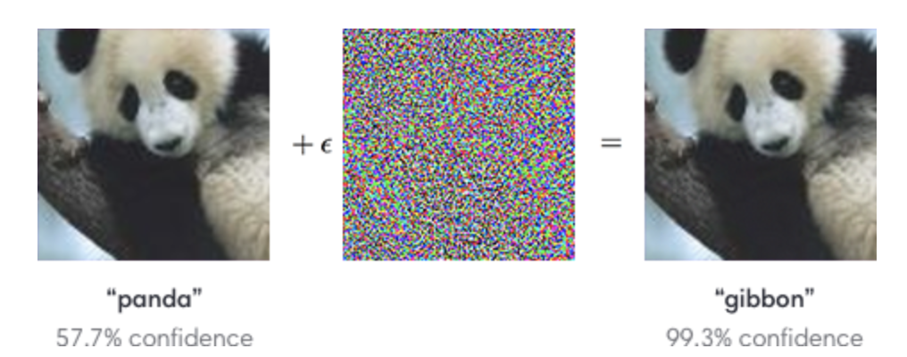
Adversarial Machine Learning
Evasion Attack
How can we build a robust machine learning model to detect phishing domains and overcome these evasion attacks?
“Explaining and Harnessing Adversarial Examples”
https://arxiv.org/abs/1412.6572
Actual unimpressed gibbon
This Photo by Unknown Author is licensed under CC BY-ND

Slide 4
Generative Adversarial Machine Learning
Generative Adversarial Network (GAN)
  Two neural networks contesting with each other in zero-sum game
    Generator: constructs candidates
      Goal: Synthesize examples that appear to be from a desired distribution
    Discriminator: evaluates candidates
      Goal: Distinguish between synthetic samples and true population
Idea:
Use a GAN to develop synthetic ‘phishing’ domains (adversarial examples) and improve the strength of a machine learning classifier.
Hypothesis:
A classifier trained against an augmented set of domains will perform better than a classifier trained without generated examples on the same test set.

Slide 5
Datasets for Classifier & GAN
Benign Data Sources
  Alexa Top 1 Million (top 25K)
  Umbrella Top 1 Million (top 25K)
  OpenDNS Random 10K
Phishing Data Sources
  OpenPhish Threat Feed
  PhishTank Threat Feed
  DNS-BH Threat Feed
  (phishing domains only)
 | No. Training | No. Testing | Total
Benign | 51,951 | 12,988 | 64,939
Phishing | 42,834 | 10,709 | 53,543
Total | 94,785 | 23,697

Slide 6
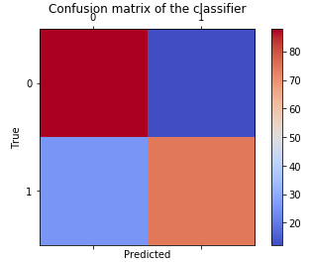

Initial Phishing Domain Classifier
Features Used
Length of domain
Number of subdomains
Has ‘-’ in domain
Term/stem frequency count
Ngram counts
Random Forest Classifier in Python 3 using sci-kit learn model
  500 estimators
Final model score on test set: 81.74%
    0 = benign
    1 = phishing
Notes:
Terms: account, customer, login, payment, support, secure, update, verify
Stems: secur, updat, verifi

Slide 7
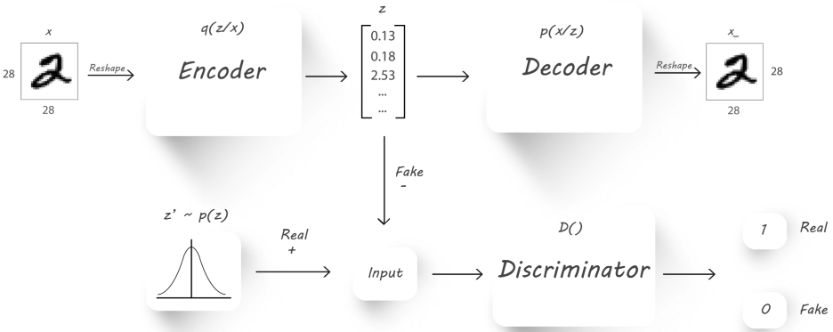
GAN Choice: Adversarial Autoencoder (AAE)
Two basic goals
Encoder, through the discriminator, learns to create representations that resemble random samples from a target distribution
Decoder can “recover” original input from any sample from the target distribution and also functions as a stand-alone generator
https://towardsdatascience.com/a-wizards-guide-to-adversarial-autoencoders-part-2-exploring-latent-space-with-adversarial-2d53a6f8a4f9
Notes:
Code modified from GitHub project (https://github.com/eriklindernoren/Keras-GAN)

Slide 8
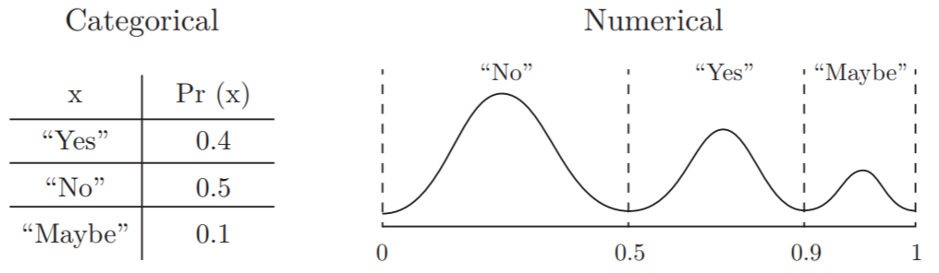
Converting Domains to Vectors
Discard domains with > 50 characters
  Too challenging for the encoder/decoder
Fix domains to length 50 (pad with spaces where needed)
Use categorical transformation similar to one described in [1] to construct numeric vector
1: https://dai.lids.mit.edu/wp-content/uploads/2018/03/SDV.pdf

Slide 9
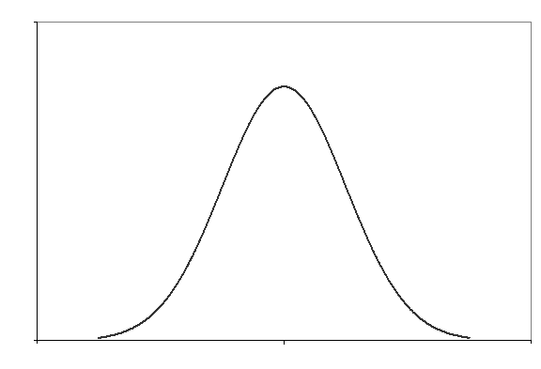
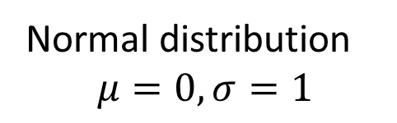
Decoder as Stand-Alone Generator
z’
1.2
0.3
...
0.7
Decoder
www.haiopiia-opdlmnrn.tmre
sample
Generated domain
Normal distribution
$$μ=0, σ=1$$
Example Generated Domains | Real Phishing Domains
cosecsoettcs.c | www.qapiseq.ml
www.i-as2oa.oo | olusesanekisola.com
www.pormcuoios.seucc.ccr | jisukcho.com
fooanbsocser.ca | www.jualumni-bd.org
cacnj-bcmectmete.mom | zyhber.com

Slide 10
Test Set Results: Original & Augmented Classifiers
4 models tested
  Original classifier
  50K classifier
    Training set augmented with synthetic domains
  100K classifier
    Training set augmented with synthetic domains
  New malicious classifier
    Training set augmented with more real phishing domains
Test Set | Model | Accuracy
Original | Original | 81.74%
 | 50K | 81.81%
 | 100K | 81.78%
 | NewMal | 81.71%
50K | Original | 80.82%
 | 50K | 83.26%
 | 100K | 83.3%
 | NewMal | 81.82%
Test Set | Model | Accuracy
100K | Original | 80.84%
 | 50K | 83.28%
 | 100K | 83.29%
 | NewMal | 81.86%
NewMal | Original | 81.39%
 | 50K | 81.56%
 | 100K | 81.54%
 | NewMal | 81.91%
Original classifier is outperformed on all test sets

Slide 11
Real World Testing Results
Model | % of Domains flagged with probabilities above given threshold
 | .5 | .6 | .7 | .8 | .9 | 0.95
Original | 51.93571 | 39.3 | 33.82857 | 15.15714 | 7.814286 | 4.771429
50K | 43.16429 | 34.22857 | 27.49286 | 10.34286 | 5.842857 | 4.564286
100K | 50.84286 | 41.45 | 21.27857 | 14.94286 | 6.1 | 2.671429
New malicious | 38.43571 | 31.87857 | 23 | 10.65714 | 5.235714 | 3.857143
Each model tested on over 10,000 domains (no ground truth labels)
  Not necessarily all the same domains, but likely to overlap
Original model shows highest potential for false positives
  Consistently flags the highest number of domains
100K and new malicious model show good potential for operational use

Slide 12
Conclusions & Future Work
Augmented models appear to outperform original model
  Updated threat feeds and/or more diverse training data may result in a better model
  Additional testing/metrics/evaluation to be done before concrete conclusions
GANs show promise as a means of acquiring additional training & testing data for the purpose of building a more robust classifier
  Many ways to extend & improve work
    Continue development on original model
    Experiment with alternate GAN architectures & encoding methods
    Hand-select data used to train GAN
    Introduce fitness function as additional way to measure quality of output of GAN

